Slide 1
SESSION 6 – Key Note by IMG Productions

Slide 2
Session6: Key Note
Part I: Introducing IMG Productions
World’s largest producer of sports content
More 21.000 hours per year
Facilities in London, New York, Oslo, Singapore, Glasgow, Stockholm & Sydney
Clients/sports include:
Football: English Premier League, FIFA, UEFA, MLS, …
Rugby: IRB World Cup, …
Tennis: All England Championships of Wimbledon, …
Golf: Open Golf Championships, European Tour, …
Cricket: BCCI for IPL Cricket, …
Mass Participation: New York Marathon, …
Sports news agency SNTV (in partnership with Associated Press)
Own 24/7 live sports channel for airline & cruise industry
Olympic links as:
involved in host broadcast production of various Olympic Summer & Winter Games
involved in content production for the Olympic Channel
FEI Sports Forum, 4-5 April 2016, IMD Lausanne

Slide 3
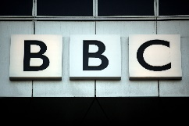
Session6: Key Note
Terrestrial TV
Private & Pay TV
Social Media
OTT Platforms
FEI Sports Forum, 4-5 April 2016, IMD Lausanne
Notes:
Until the mid 1990’s the only option for rights holders such as the FEI was to sell their product to the terrestrial broadcasters, many of whom were state broadcasters and who through the EBU in Europe and similar groupings elsewhere were able to keep prices down
Then with ESPN in America and Sky Sports in Europe rights holders had more options.
And the arrival of Social Media gave rights holders another option.
Hand in hand with technology that made social media possible came the arrival of streaming on platforms like FEITV and Sky Go or Sling

Slide 4
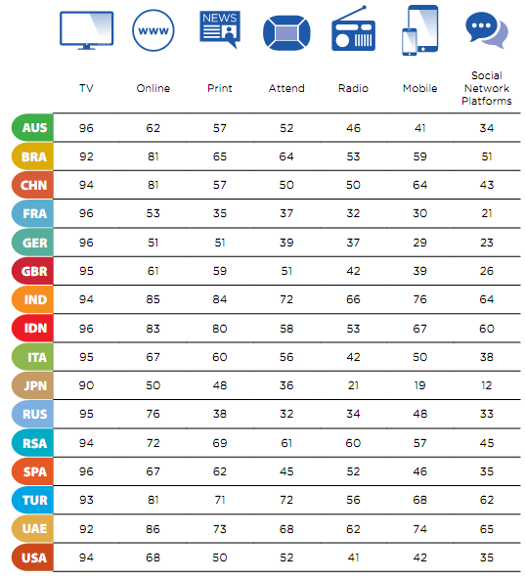
Session6: Key Note
Methods fans use to consume sports today
Figures reflect development
However: TV still by far most relevant (will remain for 2020 & 2024)
Use of digital platforms increasing quickly
Type of content consumed varies according to method
Choice for fan is increasing
Common key factors for success & non-success
* All figures: “Know the Fan – The Global Sports Media Consumption Report” by Perform, Kantar Media & SportBusiness
FEI Sports Forum, 4-5 April 2016, IMD Lausanne

Slide 5
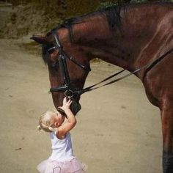
Session6: Key Note
Key success factors:
“KISS” approach:
Keep
It
Short &
Simple
Be reliable (start & end-times/pre- & post planning)
Be easy to understand (audience not clever)
Deliver drama & entertainment (but no circus)
Tell a story
Provide confidence
FEI Sports Forum, 4-5 April 2016, IMD Lausanne

Slide 6
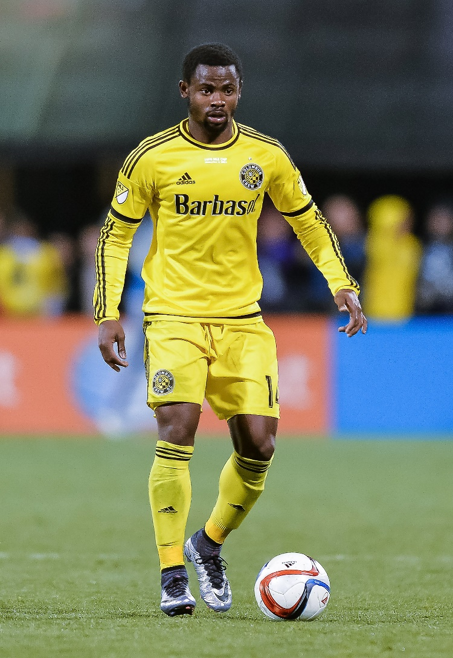
Session6: Key Note
Case Study I: Major League Soccer (MLS)
Despite 1994 FIFA World Cup™, David Beckham joining LA Galaxy in 1997 and both Men and Women’s team doing very well as recently as 2011 NBC signed a three- year deal for as little as $10m.
Now attendance is up 35%, Franchises are being sold for over $65m as opposed to $8m a few years ago and ESPN/Fox deal worth $90 a year
FEI Sports Forum, 4-5 April 2016, IMD Lausanne
Notes:
There are several sports or federations that have gained massively from the options I have just mentioned. But they have all had to make changes to their rules and regulations and to understand that broadcasters need to be treated as partners and not just pay masters.

Slide 7
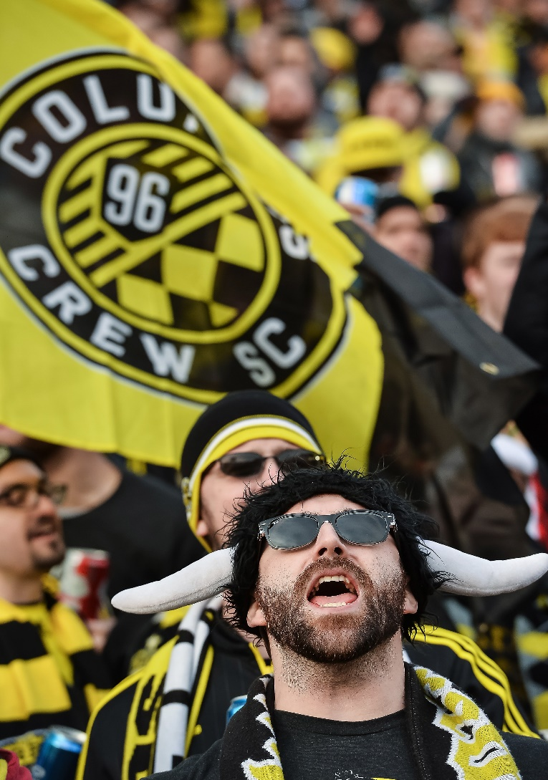
Session6: Key Note
Case Study I: Major League Soccer (MLS)
Schedule confirmed 6 months ahead -no changes allowed- TV companies now feel confident their schedule will be correct
A reorganization of the league meant their was an easy to understand format with the play offs now being clear
IMG was appointed to make an international highlights programme
We concentrated on telling stories about people.
MLS listened to broadcasters about what time of day they wanted matches and durations
FEI Sports Forum, 4-5 April 2016, IMD Lausanne
Notes:
MLS realised that a schedule had to be agreed months in advance and could not be changed. Until then broadcasters had not been sure that an event would happen on the day and at the time stated. They reorgansied their league system so that instead of confusing systems that were hard to follow it was now easy to see how a team would qualify for the play offs. In FEI terms it is similar to the discussion about the Nations Cup. It is confusing for viewers to watch a round and be told it doesn’t matter what happens this round will not be counted. Sport CANNOT ever be irrelevant. Through the international highlghts programme we ensured that viewers did not just see an American viewpoint..something we try to do with Equestrian World for the FEI. MLS listened to broadcasters about what works and what does not work. In FEI terms there may be a discussion to be had about Dressage for instance. The broadcasters say 8 minutes is too long for a display..Gymnastics has roughly 2 minutes of display. Figure Skating 3 minutes..Synchronised swiiming is 2 minutes. Is their an argument Dressage should be shortened? Or maybe the FEI do what Cricket has done and keep the 5 day format but introduce the 20/20 format which last 3 hours. It is not a coincidence that Rugby 7’s is in the Olympicsd but 15 man Rugby is not.The future of this sport is with the 15-30 year old group. The FEI MUST attract and keep this audience..it is your future. In this digital age where no one watches anything for more than 2 minutes (You Tube stats) then 8 minutes may be too long.

Slide 8
Session6: Key Note
Case Study I: Major League Soccer (MLS)
MLS came up with a standard international offering.
5 minutes before kick off, the first half, half time highlights, the second half, 5 minutes of post match interviews and analysis
MLS realized the importance of data/infographics
MLS contract with broadcasters states managers and two players from each team as selected by broadcaster MUST be available post match interviews
MLS allowed cameras into places NFL/MLB never had (referees, changing rooms) and were open to new technology such as heart monitors and even vest cameras
FEI Sports Forum, 4-5 April 2016, IMD Lausanne
Notes:
MLS came up with a standard international offering, whether in Madrid or Mexico, London or Los Angeles the viewer watching an FEI product would be comfortable he or she knows this IS an FEI product because wherever it is in the world it follows a pattern. This is the same in many sports such as Basketball. The FEI graphics and information system is also not standard. Sometimes the viewer is given almost no information about the horse and rider. In addition as the FEI representative IMG often has to fight and plead for interviews. The MLS made sure that any team that took part HAD to offer up the manager and two players for post match interview. Maybe the FEI should consider similar rules? Finally MLS is open to new ideas and technologies that make the sport more attractive to viewers. IMG and all broadcasters understand that safety is the first thing we should worry about, but if we can now put a live camera on a jockey on a horse race over big fences (which we can) should we not be considering what the FEI would allow for Equestrian sport?

Slide 9
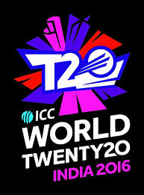
Session6: Key Note
Case Study II: ICC World Twenty20 - Cricket
ICC realized that traditional cricket was dying-no attraction for 15-25 year olds
Created 20/20 format to appeal to that audience. That age group has a problem with concentration & patience. The short version much more attractive to them
It is glamorous (cheerleaders & famous personalities at the ground, etc.)
Sponsors are very attracted to it
Viewing figures for 20/20 nearly double those of 5 day test matches
Shortened format lives hand-in-hand with traditional format
FEI Sports Forum, 4-5 April 2016, IMD Lausanne

Slide 10
Session6: Key Note
Case Study III: Rugby Sevens
Easy to follow-requires no previous knowledge of Rugby to follow.
Fewer players-appeals to IOC who need to cut athlete totals
Flashy exciting play with big hits and in a short space of time
No stoppage in play, almost every second is pure action
Appeals to commercial broadcasters because they can go to a break every 7 minutes instead of every 40 minutes
‘It’s fast exciting and totally entertaining’ said a leading broadcaster
FEI Sports Forum, 4-5 April 2016, IMD Lausanne

Slide 11
Session6: Key Note
THANK YOU!
FEI Sports Forum, 4-5 April 2016, IMD Lausanne

