Slide 1
FEI VAULTING FORUM FEBRUARY 3, 2023
FUTURE OF THE SPORT

Slide 2
AGENDA
Purpose of the session
FEI wants your opinion – survey numbers
Outcome of the surveys
Discussion

Slide 3
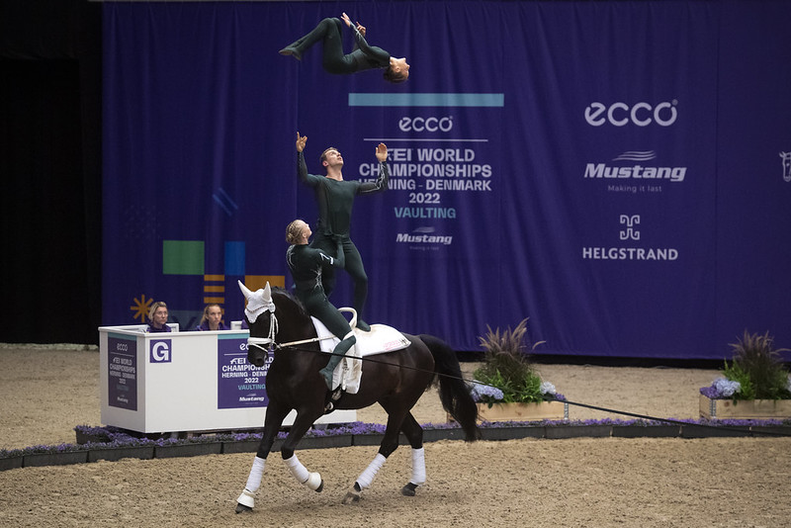
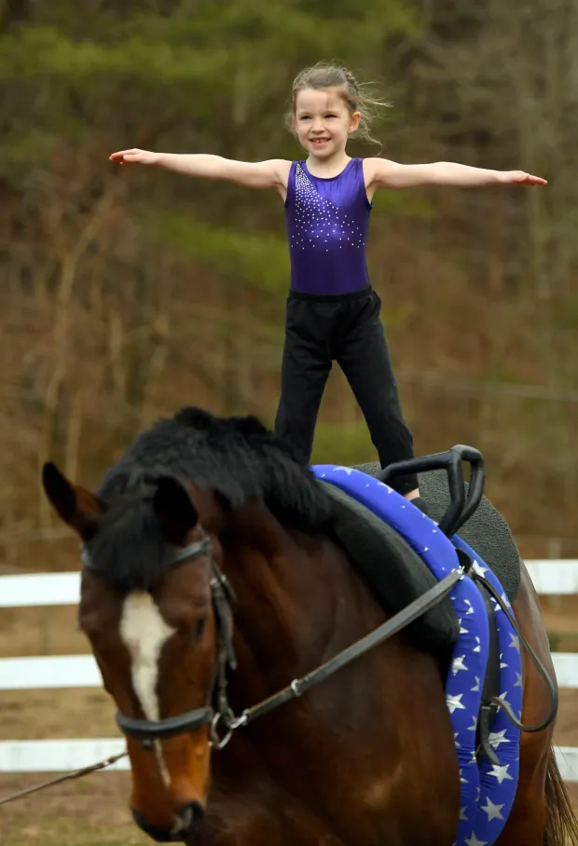
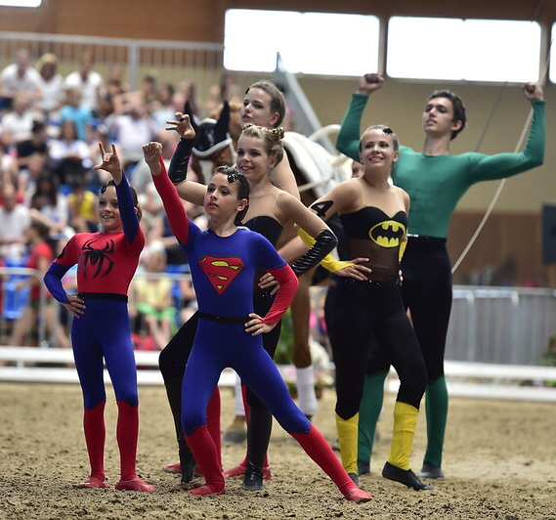
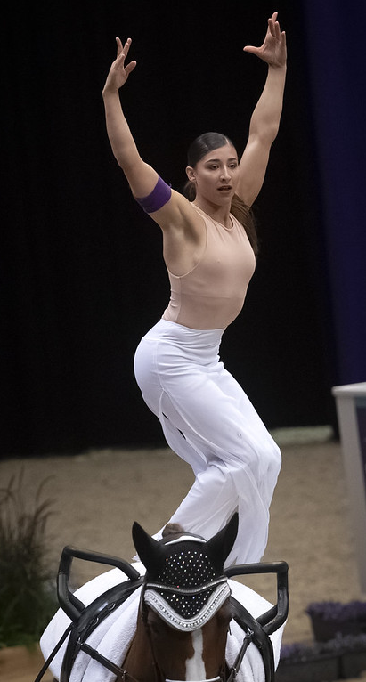
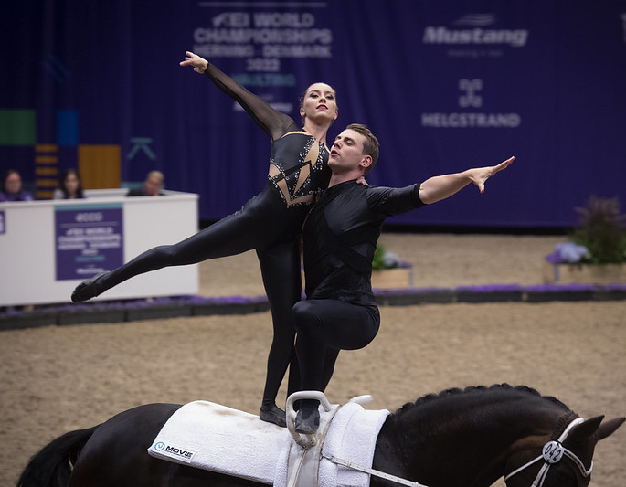
PURPOSE OF THE SESSION

Slide 4
SURVEY IN NUMBERS
Announcement and distribution channels:
The Survey was sent out on 21st January and was due to be filled in on 31st January
Survey was sent to:
all who enter for the Open Online Forum
to all officials through FEI Education department
To all officials through International Vaulting Officials Club (IVOC)
To all officials through Facebook page of FEI vaulting officials
Through private channels and contacts of the Vaulting Technical Committee members

Slide 5
SURVEY IN NUMBERS
9 questions:
1.1 What region are you from?
1.2 What is your role in Vaulting? Check all that apply
2.1 What is your favourite thing about vaulting?
2.2 What do you not like about Vaulting?
3.1 How much do you like a vaulting competition
Individual, Pas De Deux, Squad, Nation Team – rate each one from 0 – 10
3.2 Short explanation why

Slide 6
SURVEY IN NUMBERS
Survey contained 9 questions:
4.1 Please rate the different tests.
Compulsory, Free Test, Technical Test – rate each one from 0 – 10
4.2 Short explanation why
5. What main problems do you face in vaulting?
6. What do you think could be improved/changed in the Individual/Pas de Deux/Squads/Teams competition?
7. What changes would you like to see in the next 5-10 years in the sport?

Slide 7
SURVEY IN NUMBERS
8. What do you think we can do to promote our sport better?
9. What should be prioritized by the FEI Vaulting Technical Committee, and why do you feel this is important?

Slide 8
SURVEY IN NUMBERS
Methodology:
The Survey was a mixture of question with ratings and open questions
The questions with rating were evaluated based on mathematical methods
At the open questions we have identified the most mentioned areas of the feedback and numbered them to get a ranking

Slide 9
1.1 What region are you from?
165 surveys filled in (until 1st February, 2023)
96 Europe
69 Outside Europe

Slide 10
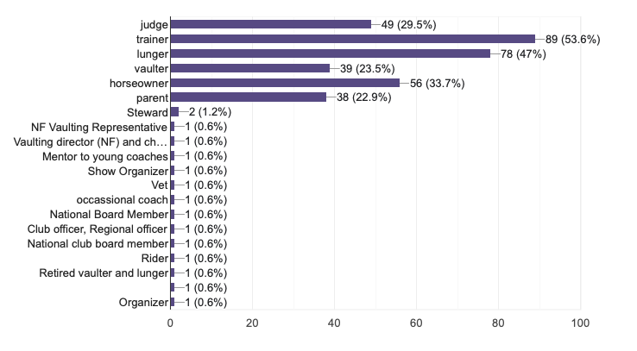
1.2. What is your role in Vaulting?

Slide 11
2.1 What is your favourite thing about vaulting?
160 responses
The supportive community that IS vaulting. It’s unlike any other sport or equestrian discipline. People really generally seem to compete for score and not against each other. There is a lot of respect and support across teams, nations and clubs.
The relationship between vaulter, lunger and horse. It is Not only a Sport, it‘s a lifestyle, a big family! Elegant and Akrobatic in harmony with the horse!
The team spirit combined with the responsibility for the / with the horse, the combination of creativity and athletic of the sport
The team spirit between all and all the opporturnities to compete even when not able to transport your own horse
The work with the horse and the trust. The combination of strengh, flexability and technique.
It grows good people. Vaulters make awesome adults. Love & consideration of horses.
Teamsport, working together with a horse, complexity of the sport
Being in harmony with you horse and team, challenging myself, feeling free, moving, putting emotion in your freestyle
Working with my horse and creating freestyles!

Slide 12
2.2. What do you not like about vaulting?
146 responses

Slide 13
2.2. What do you not like about vaulting
Welfare of horses/Availability of the horses
There is a pretty profound lack of horsemanship. It shows that many of these clubs are vaulters first and horse owners second.
People who do things on the horse without being capable of doing the exercise on the barrel/ Movie . The horse is the most important in vaulting there should be more attention for good vaulting horse training. And vaulters shouldn’t do exercises on the horse which they don’t manage/control on the barrel/movie.
Horse welfare issues -- unfortunately some people do not put the horses first. This is wrong and makes the sport look very bad. Consideration for the horse is not weighed heavily enough in scoring.
Trainer/ lunger without feeling for the horse
Squads that appear to overload the horse, that our sport is sometimes criticized

Slide 14
2.2. What do you not like about vaulting?
Judging
I find that the judging of horses and vaulters feels more "subjective" than objective.
Having to guess if the judge will recognize my music and therefore character
Incompetent judges and officials
judging system, even people involved in the sport for many years can’t predict the results , for spectators it’s impossible to compare text in the rule book with real performance …
Certain judges judge a lot and the new judges do not have many opportunities
The unfair judging (and the parents...)

Slide 15
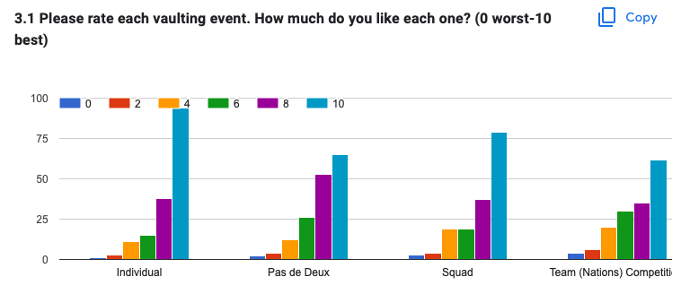
3. How much do you like Individual, Pas Dedeux, Squad and Nation team competition?
Score 8,54
Score 7,95
Score 7,99
Score 7,47

Slide 16
3. How much do you like Individual, Pas Dedeux, Squad and Nation team competition?
And why?:
144 responses
Many open answers were in favour for all competitions
Love everything, but if I had to pick just one it would be individual, competing against yourself. Team/squad are very important as well
Each event has own moments.
I enjoy all of the events in vaulting because they each bring something unique to the arena.
Individual is the top, PDD is connection, Squad is teamwork, Nation team is must have, but meaningless
All of them are amazing events and the vaulters work extremely hard.

Slide 17
3. How much do you like Individual, Pas Dedeux, Squad and Nation team competition?
And why?:
Squads – PROs/CONs
The squad division does not seem to have the same caliber of professionalism as the other divisions, and there seems to be a common issue with welfare for the horse. Individual and Pas de Deux do not seem to carry this same issue generally.
Squad is great because in many ways it is the pinnacle of vaulting (perfect cooperation between the vaulters and the horse), but too many teams focus so much on building tall lifts and doing acrobatics even when it is not best for the horse.
If the squad is controlled and well performed, I enjoy it very much. However, it is often hard on the horse and sometimes even scary to watch.
Team competition is great because it combines multiple events, super fun to watch and great way to promote the sport I think.
Squad is the most exciting to compete in and watch

Slide 18
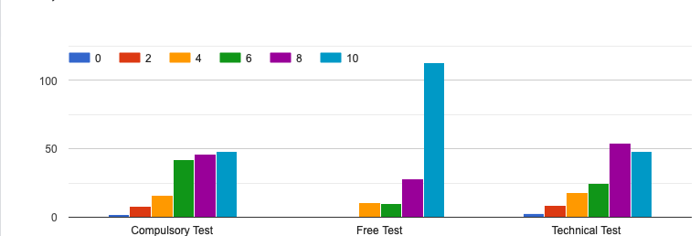
4. How much do you like compulsory, free test, technical test?
Score 7,25
Score 9,00
Score 7,32

Slide 19
4. How much do you like Individual, Pas Dedeux, Squad and Nation team competition?
And why?:
134 responses
Compulsory – test mentioned the most
Although compulsory can be boring, I think it is EXTREMALY important for the vaulters to develop and it is the best thing to level the individuals (you can only move up a category if you are able to perform in both compulsory and freestyle).
Compulsory test is very interesting because of its technical components, but its all so a little boring, even more for the people who doesn’t understand well the sport
Compulsory test is boring, I would only keep technical and free tests.
Compulsory boring for visitors.
The compulsory is good up to a certain level, then we need to just have tech tests and free tests.
I prefer the technical aspects of compulsory test. These tests require more harmony with the horse than freestyle.
Compulsories are the yoga of the sport. Free test is where the magic happens. The tech test is the acceptance of risk.

Slide 20
5. What main problems do you face in vaulting?
156 responses

Slide 21
5. What main problems do you face in vaulting?
Horse Availability
Horse availability and training. At the moment we have the funds to buy a vaulting horse (for the NF) but we just cannot find ones that are good enough at the price range. Breeders mainly focus on jumping
We are struggling with finding good and healthy horses and with the fact that vaulters have to be good at so many different parts (strength, flexibility, coordination, feeling the music,…). It‘s difficult to train everything.
It's hard to find good vaulting horses. Special for squad.
Horse availability and money, even if we put down a lot of time in the vaulters training it’s always really expensive to have your own horse or to rent one. And because it’s such a small sport (hard to get sponsors) and barely any money to earn on competitions it’s sometimes hard to argue on why to continue working so hard.
Horse availability is most challenging to keep a club progressing currently.
Horse availability, skilled trainers and high training costs
Horses! We don’t have enough horses especially at the higher levels. It’s difficult to find, train and support a high level horse.

Slide 22
5. What main problems do you face in vaulting?
Money
our club is small, in an area that has a lower population and not a lot of money. we struggle with recroutment and fund raising to have enough money to do demonstrations and competitions, as well as to support our horses.
I struggle with horse availability, access to coaching, borrowed horses, and training apparatuses. I also struggle with being able to fund travel to get to an adequate amount of competitions.
To find subtile horses, raising costs for competitions
Travelling to the big competitions without enough money, we need more sponsors in this sport to be able to assist and train better because for most of the vaulters it’s a hobby/passion and to combine with work/studies it’s hard and some nations don’t support this sport as much as others, like France/Germany, which makes it hard sometimes to get to the same level.
Being located in a distant Country on difficult time zone for participation in webinars. Cost of travel to Europe has sky rocketed.
Expensive sport.

Slide 23
5. What main problems do you face in vaulting?
Struggling with guidelines understanding/difficult to train - trainers
Remembering all the rules
I am struggling with knowing exactly how judges score the artistic score in a tech or freestyle.
It's hard to understand how the judges judge the athlete in freestyle, and how the point are added together.
Improve the vaulting rom national degree to international degree. The exercises are very difficult from year to year. The international level is high.
Sometime I struggle to understand the code of points. I can't picture what the description is.
Misunderstandig the rules.
ever changing rules, explaining scoring to parents

Slide 24
5. What main problems do you face in vaulting?
Struggling with guidelines understanding/difficult to judge - judges
The education system is not fully thought through and implementable. It is seen as a privilege to become a judge, and the high costs involved do not come close to recovering.
Education system could be bottom-up organized and built. We lack enough professional officials.
I am struggling with the horse score and artistic score.
The judging is too complex.
The evaluation of horses is sometimes not so clear-cut. And artistic score can often be very subjective. It's difficult to judge structure and artistic at the same time.
Many many rules and guideline changes in very short period. Getting tired of all the online sessions, forums, etc.
Sometimes the logic is not clear in the rules, COP. Artistic is the hardest thing to score.

Slide 25
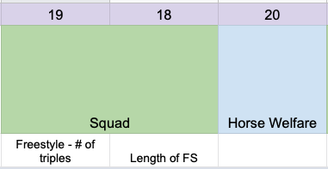
6. What do you thing could be improved/changed in the individual/Pas De Deux/Squads/Team competitions?
125 responses

Slide 26
6. What do you thing could be improved/changed in the individual/Pas De Deux/Squads/Team competitions?
Squad – the length of the free test, number of squad members, limit the number of triples.
Squads. I think are the hardest on our horses with 3 people on for a longer period of time or even just having to canter longer rounds during practice. There are a lot of options I could see helping us with that: shortening the FS time for teams, having less people on a team, asking for less triples.
Squad - change the rules because of heavy exercises and triples
Shorter times of freestyles, probably less people in the squad, restrictions on the number of triples, diminishing or deleting the DOD, as it changes almost nothing in scores - more focus on harmony with the horse and composition
Decrease Squad FS length to 3 minutes. Decrease PDD time to 1.5 minutes (3*). Limit number of triples for all levels of squads (6 static triples). Change static compulsories to be held for 3 strides (consistent with FS and TT)
I strongly believe squad freestyle should be brought down to 3 minutes in length. Or perhaps a new division entirely, something like 4 vaulters total, with a limit to how many triples they perform? Something needs to evolve soon in this division.

Slide 27
6. What do you thing could be improved/changed in the individual/Pas De Deux/Squads/Team competitions?
Horse welfare
Teams *3 senior: Fewer three-man exercises to take care of the horse
Decrease the amount of time for PPD to 90 seconds and squad to 3 minutes. Putting the horse first since without the horse, there is no sport. Potentially getting rid of mandatory outside ground jumps and excessive time on the neck.
I think the knowledge about how to train and manage a vaulting horse could be lots better
Horse welfare should be the highest importance, judges should accept way less in competition when they see a horse having a hard time.
Scoring of horses needs to have some form of oversight.

Slide 28
7. What changes would you like to see in the next 5 – 10 years in sport?
125 responses

Slide 29
8. What do you think we can do to promote our sport better?
146 responses

Slide 30
8. What do you think we can do to promote our sport better?
Professional communication on social media set up by experts. Regular content, campaigns, teasers, all collected, organized and spread by one entity.
Social Media/Media coverage/Advertisement
Giving people an insight into our sport and how we train (maybe trough instagram, tv, facebook, newspapers,…)
Better work with social media: interviews with athletes, trainers, judges,... Provide transparency and insights into the structure, explain backgrounds clearly in contributions (content/videos). Constitution of influencer for the sport. You have to show the general public what's actually behind the sport, something that you don't immediately see at first glance.
I think Haley Smith with Instagram is showing how it’s done with over millions of views. Get the attention and the sponsors is very important and over social media’s like Instagram or Tik tok vaulting is getting more and more known by people. Or like France assisting to "The France got talent" is helping many people to know the sport

Slide 31
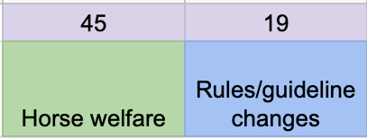
9. What should be prioritized by the FEI VTC?
113 responses

Slide 32
9. What should be prioritized by the FEI VTC?
More emphasis on consideration of the horse in the rules/scoring. Also greater clarity in rules/scoring for the Artistic score (especially C3 and C4).
Rules/Guidelines changes
Be realistic about what any one person can judge (even if there are multiple judges).
The innovation and performance are very important.
It seems that FEI Committee works on so many things, that we have no clue what they prioritize themselves. Updating the Degree of Difficulty would be helpful to all.
Change the squad freestyle, and make it easier and more light for the horse! make horses happy athletes, not struggling devices
Changing the restrictiveness of the Artistic score (C-1, C-2) in the Free Test, to allow more artistry, musicality and uniqueness to come through.

Slide 33
9. What should be prioritized by the FEI VTC?
Do more research so we can either change our rules or show why our old rules are good, so everyone can understand that vaulting has done everything to make this sport as safe as possible for horse and the vaulter without losing it's idea. And with promoting our science based research and rules, we can show to other equestrian sports that it is possible to get the social license by changing thing if needed and still keep the idea of the sport alive.
Horse welfare
I think the work you do is great. I think it's important to prioritize and look at what's going to take the sport in the direction we want it to go in a sustainable way. Priority always has the strongest link, which is the biggest for a crisis (in our case: Wellfare of the horse)
Horse welfare, making sure that any rules changes and proposals align with taking care of our horses. Taking into account how the changes will affect the lower levels and not just the elite. Even though FEI events focus on upper levels, most countries adopt FEI rule changes for their lower levels as well, so trying to put that into perspective when proposals are made.
I think the side rein research is great start, so I wish vaulting community to do more research based on science.

Slide 34
Q&A

Slide 35
THANK YOU

